Slide 1
IMAGE COMPRESSION BASE ON DCT DWT
2012/12/07
Ying Wun, Huang

Slide 2
OUTLINE
Why DCT DWT?
Proposed Method
Proposed Method-Residue
Appendix: C Code Interview Questions

Slide 3
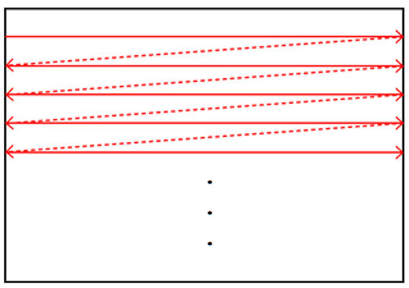
Why DCT DWT?
The scan order of loading image

Slide 4
Why DCT DWT?
 | Block size | Buffer size
JPEG | 8×8 | 8×512
JPEG2000 | 32×32 (64×64) | 32×512 (64×512)
DCT+DWT (Proposed) | 8×512 | 8×512

Slide 5
Proposed Method
8×256 DCT DWT Compression

Slide 6
Proposed Method
DCT+DWT

Slide 7
Proposed Method
JPEG×JPEG2000 Quantization
16
12
14
14
18
24
49
72
First row of JPEG2000
×
÷12
First column of JPEG
1 | 1.5 | 2.25 | 2.25 | 3.375 | 3.375 | 3.375 | 3.375

Slide 8
Proposed Method
JPEG×JPEG2000 Quantization
1.33 | 2 | 3 | 3 | 4.5 | 4.5 | 4.5 | 4.5
1 | 1.5 | 2.25 | 2.25 | 3.38 | 3.38 | 3.38 | 3.38
1.17 | 1.75 | 2.63 | 2.63 | 3.94 | 3.94 | 3.94 | 3.94
1.17 | 1.75 | 2.63 | 2.63 | 3.94 | 3.94 | 3.94 | 3.94
1.5 | 2.25 | 3.38 | 3.38 | 5.06 | 5.06 | 5.06 | 5.06
2 | 3 | 4.5 | 4.5 | 6.75 | 6.75 | 6.75 | 6.75
4.08 | 6.13 | 9.19 | 9.19 | 13.78 | 13.78 | 13.78 | 13.78
6 | 9 | 13.5 | 13.5 | 20.25 | 20.25 | 20.25 | 20.25

Slide 9
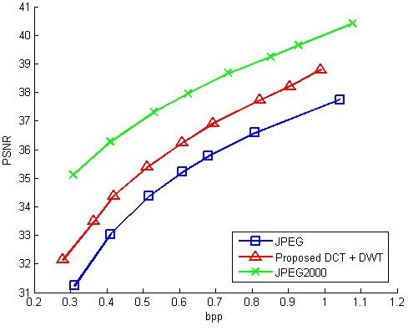
Proposed Method

Slide 10
Proposed Method-Residue
Residue With DCT DWT Compression

Slide 11
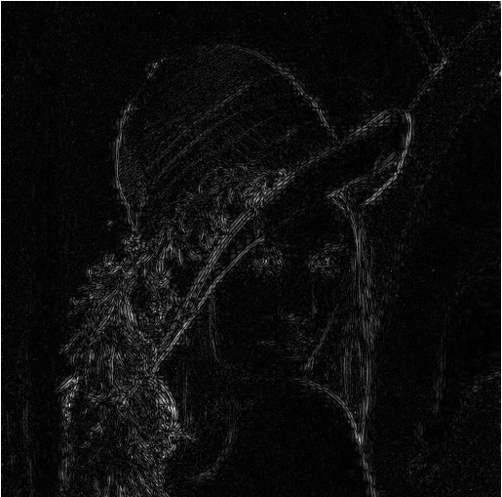
Proposed Method-Residue
-
=
512×512
Original Image
Resize:
512×512
Residue

Slide 12
Proposed Method-Residue
MPEG4-inter×JPEG2000 Quantization
16
17
18
19
20
21
22
24
First row of JPEG2000
×
÷16
First column of MPEG4-inter
1 | 1.5 | 2.25 | 2.25 | 3.375 | 3.375 | 3.375 | 3.375

Slide 13
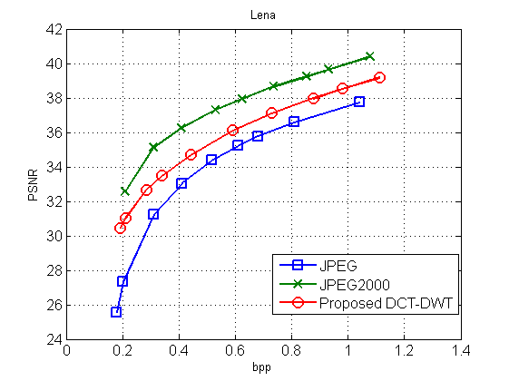
Proposed Method-Residue
Simulation Result

Slide 14
Appendix: C Code Interview Questions
Coding Style
if(x==2)
if(2==x)

Slide 15
Appendix: C Code Interview Questions
Coding Style
if(x=2)
Compile
DONE
if(2=x)
Compile
ERROR

Slide 16
Appendix: C Code Interview Questions
Example
x=2
int x=1,y=5;
if(x=2) y=3;
return;
Compile
x=?, y=?
y=3
x=0
int x=0,y=5;
if(x=0) y=8;
return;
Compile
x=?, y=?
y=5

Slide 17
Appendix: C Code Interview Questions
Property of XOR
Z = X^Y
X = X^Z
Y = Y^X
X = 7
Y = 3
X = 3
Y = 7

Slide 18
Appendix: C Code Interview Questions
Exchange two variables without TEMP
TEMP=x;
x=y;
y=TEMP;
x=x^y;
y=y^x;
x=x^y;
x^=y^=x^=y;

Slide 19
Appendix: C Code Interview Questions
Do Not Use “if else,…”
if x is true, than r=y.
r=x?y:z;
if x is false, than r=z.

Slide 20
Appendix: C Code Interview Questions
char func(char x, char y, char z)
{
return
}
x*y|!x*z;

Slide 21
The End.

